Slide 1
Additional version of installing Type-Script
scoop install touch, and the way to install separately Type-Script into VS-Code

Slide 2
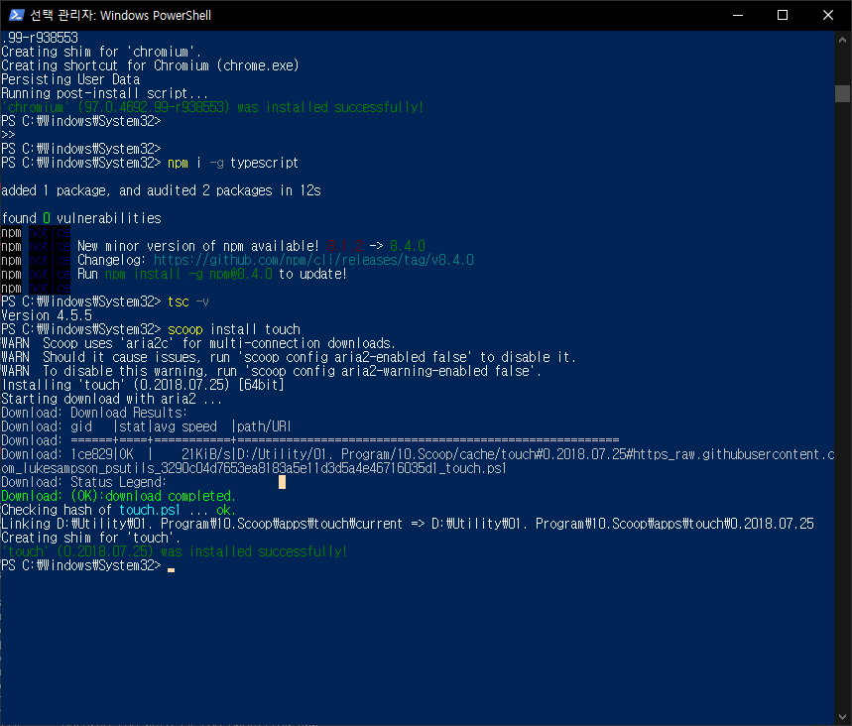
Check `touch` module installed, and then return to `VS-Code` Workspace

Slide 3
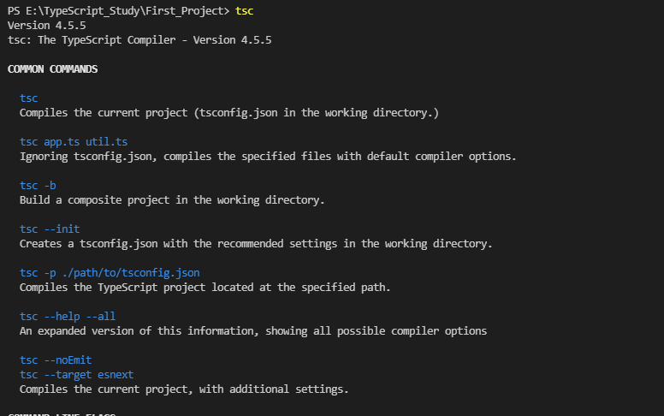
Type `tsc` in the VS-Code workspace Terminal

Slide 4

Execute TypeScript file `hello.ts` with `tsc`, And then check `hello.js` file also set

